Slide 1






Introducing the Software Sustainability Institute Date, Meeting, Location Name (@ID), Organisations ORCID: 0000-XXXX-XXXX-XXXX | email@my.domain
Supported by:
Slides licensed under CC-BY where indicated:
Notes:
These slides are licensed under CC-BY which means you may use them as you wish, however:
We ask that you do not alter any information, data or figures and pass them off as from the Software Sustainability Institute
All logos of institutions and funders must not be removed or modified

Slide 2

Software Sustainability Institute
“A national facility for cultivating better, more sustainable, research software to enable world-class research”
Providing to the wider community:
expertise, services, tools, events, policy, guidance, data, opportunities, …
Supported by the UK Research Councils through grants EP/H043160/1, EP/N006410/1 and EP/S021779/1, with additional project funding from Jisc A collaboration between the universities of Edinburgh, Manchester, Oxford and Southampton.

Slide 3
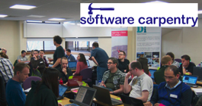


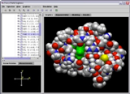
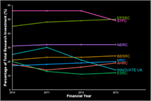
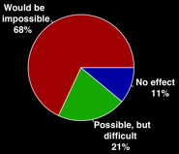





Software
Training
Helping the community to develop software that meets the needs of reliable, reproducible, and reusable research
Delivering essential software skills to researchers via CDTs, institutions & doctoral schools
Outreach
Exploiting our platform to enable engagement, delivery & uptake
Collecting evidence on the community’s software use & sharing with stakeholders
Bringing together the right people to understand and address topical issues
Policy
Community

Slide 4

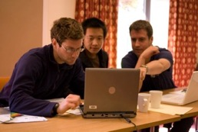
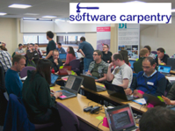






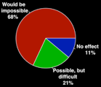

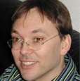

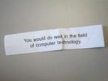

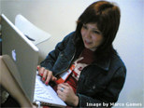
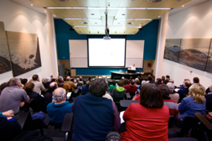
Software
Training
Advice
Courses
35+ UK SWC workshops
1000+ learners
Consultancy
50+ projects
130+ evaluations
4 surgeries
Guides
Outreach
80+ guides
50,000 readers
Website & blog
150+ contributed articles
20,000 unique visitors per month
+6,000 Twitter followers
Research
740 researchers 50,000 grants analysed
Campaigns
Workshops
Fellowship
61 domain ambassadors
300+ RSEs engaged
2100 signatures
13 issues highlighted
Policy
Community
20+ workshops organised

Slide 5
Additional Slides

Slide 6
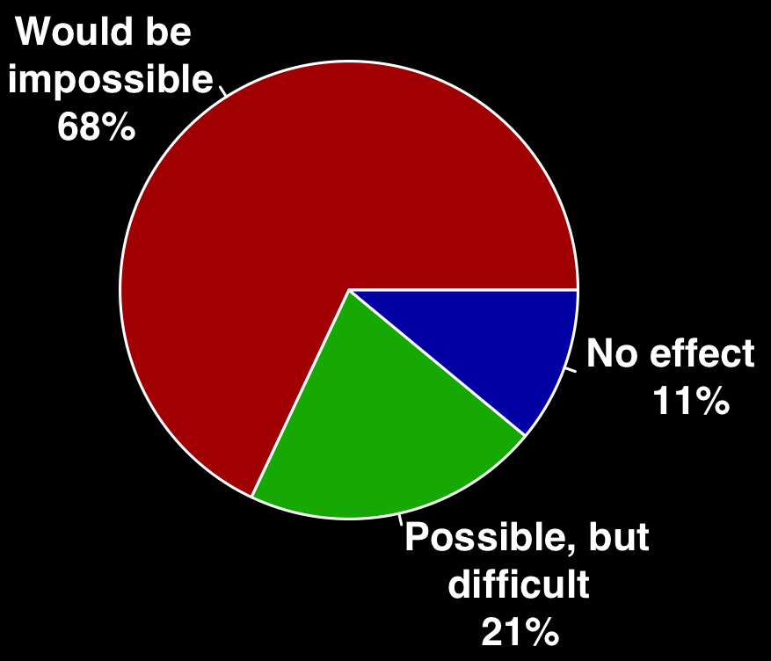
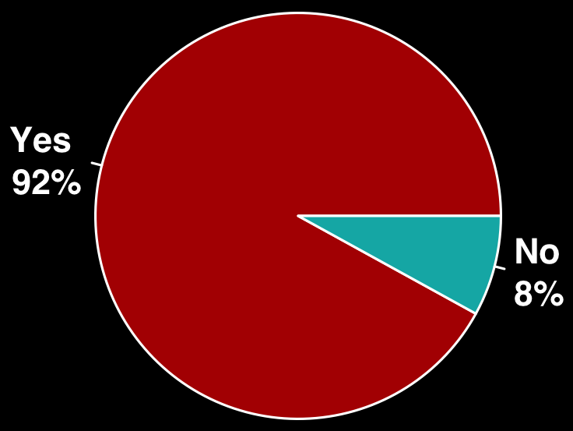
The UK research community relies on software
Do you use research software?
What would happen to your research without software
Survey of researchers from 15 Russell Group unis conducted by SSI between Aug- Oct 2014. 406 respondents covering representative range of funders, discipline and seniority.

Slide 7
The UK research community doesn’t have the skills
56%
71%
Of UK researchers develop their own research software
Of UK researchers have had no formal software development training
140,000
UK researchers are relying on their own coding skills
Survey of researchers from 15 Russell Group unis conducted by SSI between Aug - Oct 2014. 406 respondents covering representative range of funders, discipline and seniority.
Notes:
No training 46%
Self-taught + formal = 54%
Self-taught only = 25%

